Slide 1

Box Stacking I
Suppose that I have n boxes, each of which must be in a certain orientation (i.e., “this side up”).
The i-th box has a height h_{i}, and base w_{i} x d_{i} (where the width and the depth are interchangeable).
Your goal is to make the highest possible stack of boxes, holding to the following constraint:
A box k can only be stacked on top of a box m if the w_{k} ≤ w_{m} and d_{k} ≤ d_{m}.
Note that it’s possible that for any given two boxes, neither may be stacked on the other.

Slide 2
Box stacking II
Create a partial ordering of the boxes box₁, box₂, …, box_{n} such that for all i,j with i<j, box j cannot be stacked on top of box i.
Sort by base area.
Denote the height of the tallest stack of boxes with box j on the top as H(j).

Slide 3
Box stacking III
Then the height of the tallest such stack of boxes with box j on the top is given by
So the height of the tallest stack of boxes overall is given by

Slide 4
Box Stacking IV: Running Time Analysis
You can have one of n boxes on top, for each of those boxes, building up the solution, you can have O(n) boxes adjacent to it.
Another way to say this is that you start with the box you can’t stack on anything (leftmost box in array).
Then as you go up the array, the highest stack is the highest stack before that element, or the highest stack before that element plus its height.
You look at up to n boxes, up to n times, so it’s an O(n²) algorithm.
A really good set of mini-lectures on solving various dynamic programming problems is found here.
You need a 3rd-party flash-playing app to play it.

Slide 5
Optimal BST
Suppose that the cost of searching a binary search tree for an item is the number of nodes visited (the number of items looked at).
If the item isn’t in the tree, you look at items until you get to a leaf and then return failure.
Suppose we want to set up a binary search tree to minimize the total cost of searching.
We need to know the probability of searching for any given item, and the probabilities of searching for each item not in the tree.

Slide 6
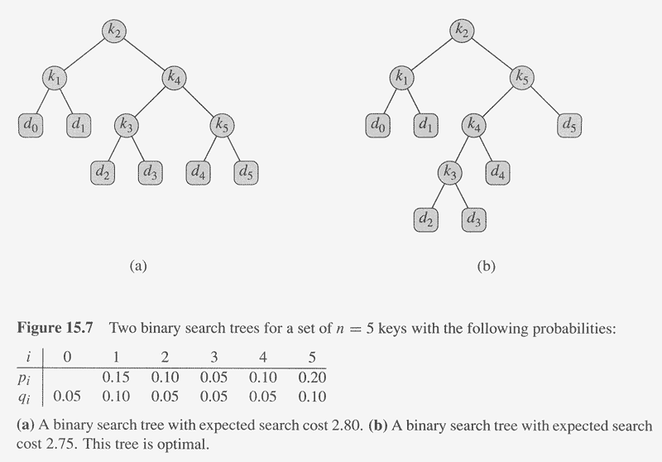
Copyright © The McGraw-Hill Companies, Inc. Permission required for reproduction or display.

Slide 7
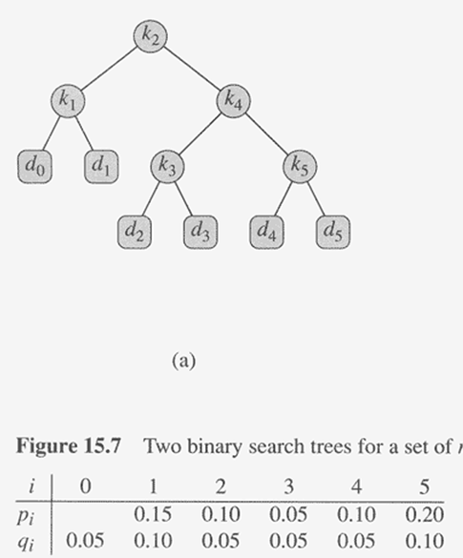
Cost of searching a BST
Key k_{j} is the search target with probability p_{j}
Someone searches for a missing element (d_{j}) between keys k_{j} and k_{j+1} with probability q_{j}.
q₀ is the probability of searching for an element with key less than k₁ (d₀).

Slide 8
Cost of searching a BST
Node | Depth | Prob | cost
K1 | 1 | .15 | 0.30
K2 | 0 | .10 | 0.10
K3 | 2 | .05 | 0.15
K4 | 1 | .10 | 0.20
K5 | 2 | .20 | 0.60
D0 | 2 | .05 | 0.15
D1 | 2 | .10 | 0.30
D2 | 3 | .05 | 0.20
D3 | 3 | .05 | 0.20
D4 | 3 | .05 | 0.20
D5 | 3 | .10 | 0.40
TOTAL |  |  | 2.80

Slide 9
Optimal Substructure in Optimal BST
If an optimal BST T has a subtree T’ containing keys k_{i},…,k_{j}, then T’ must be optimal for a BST with keys k_{i},…,k_{j} and dummy keys d_{i-1},…,d_{j}.
Key k_{j} is the search target with probability p_{j}
Someone searches for a missing element between keys k_{j} and k_{j+1} (d_{j}) with probability q_{j}.
q₀ is the probability of searching for an element with key less than k₁ (dummy element d₀).

Slide 10
Recursion
For the subtree containing keys from i to j, let e[i,j] be the expected cost of searching that subtree
(given item and failure probabilities)
Let w(i,j) be the probability that the target element is in that subtree.
Then, if r (i ≤ r ≤ j) is the root of the subtree containing keys from i to j,
e[i,j] = min_{r}(e[i,r-1] + e[r+1,j] + w[i,j])

Slide 11
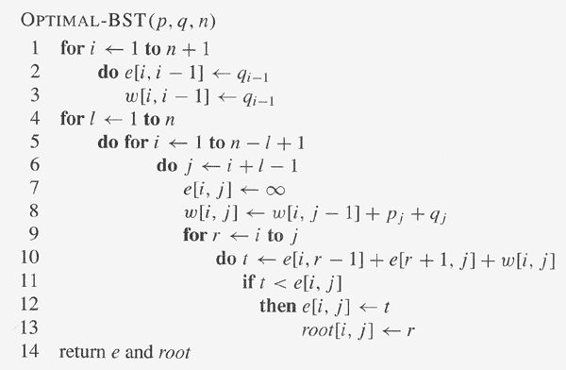
Copyright © The McGraw-Hill Companies, Inc. Permission required for reproduction or display.

Slide 12
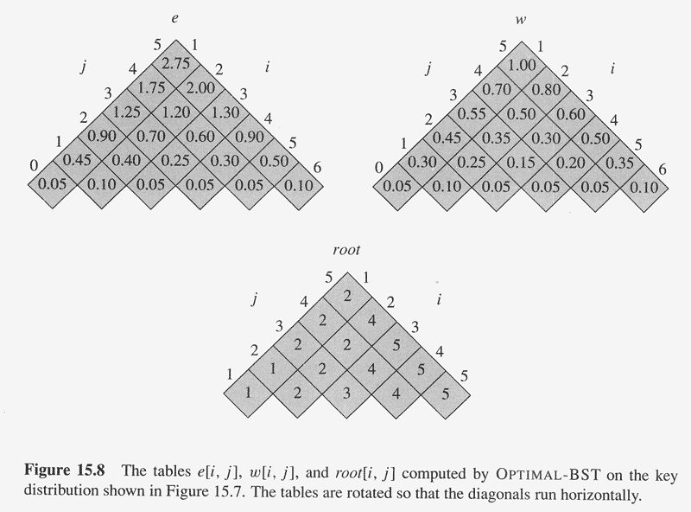
Copyright © The McGraw-Hill Companies, Inc. Permission required for reproduction or display.

Slide 13
Dropping a Cell Phone
Suppose you have designed a new, tough case for a cell phone, and you want to know
“from how many inches can someone drop a cell phone without it breaking?”
Assume you have c cell phones, and you only care about people dropping it from reasonable heights, so there is a maximum height of h inches.
If a cell phone doesn’t break, assume it is just as good as new (you can test with it again at a greater height).
Goal: Minimize the number of drops (trials) needed in the worst case.

Slide 14
Dropping a Cell Phone II
Call this problem phonebreak(c,h)
Special case: If we have 1 cell phone, all we can do is drop it from 1”, 2”, etc. until it breaks. So h trials in worst case.
If a cell phone breaks after dropping from i inches, the problem reduces to phonebreak(c-1,i-1)
If a cell phone doesn’t break after dropping from i inches, the problem reduces to phonebreak(c,h-i) (*)
(*): h-i is the number of trials. Of course, they all are at a higher height than i.

Slide 15
Dropping a Cell Phone III
So for a given height i, the worst case is:
phonebreak(c,i) = 1 + max(phonebreak(c-1,i-1), phonebreak(c,h-i))
So the minimum number of phones to drop in the worst case is:
phonebreak(c,h) = 1 + min(phonebreak(c,i))
i∈{1,2,…,h}

Slide 16
Shortest Bitonic Tour for TSP I
One way to get a possibly better tour than using some arbitrary order of cities is to do a Bitonic Tour.
Start at the southernmost city, go north to the northernmost city, then come back south.
There are a number of such tours, we want to find the shortest.

Slide 17
Shortest Bitonic Tour for TSP II
Idea: Scan south to north, maintaining optimal possibilities for each part of the tour.
Sort the cities from south to north. Assume you know the direct route distance between each pair of cities.
If there is no direct route, assume it is some arbitrarily large number (such as Java’s Integer.MAX_VALUE)
The subproblems are paths P_{ij} with i ≤ j. Start at p_{i}, go west to p₁ (stopping at zero or more cities on the way), then go east to p_{j}, picking up the other cities on the way.
p_{i} may be p_{1.}

Slide 18
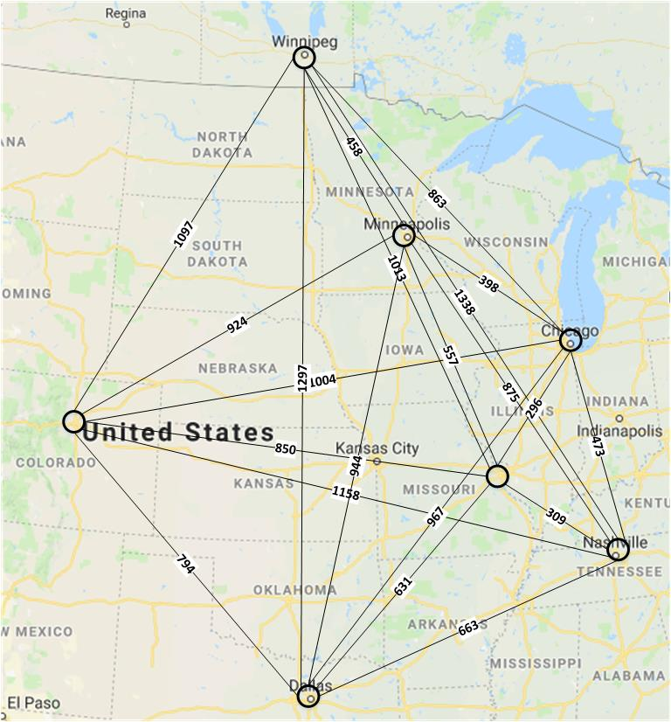
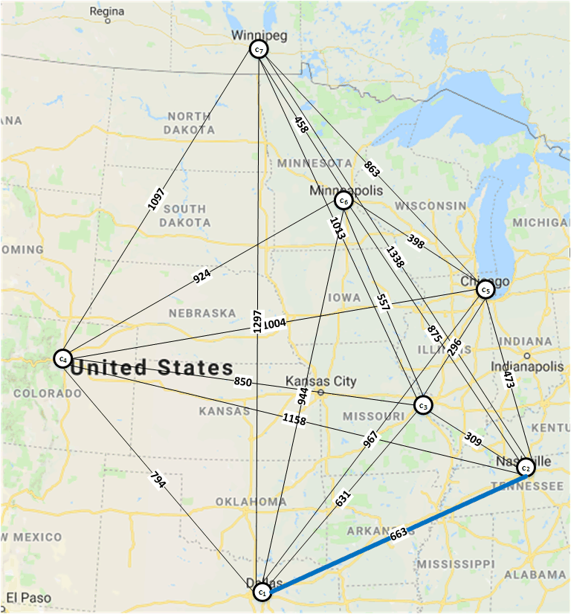
Example of South → North Tour

Slide 19
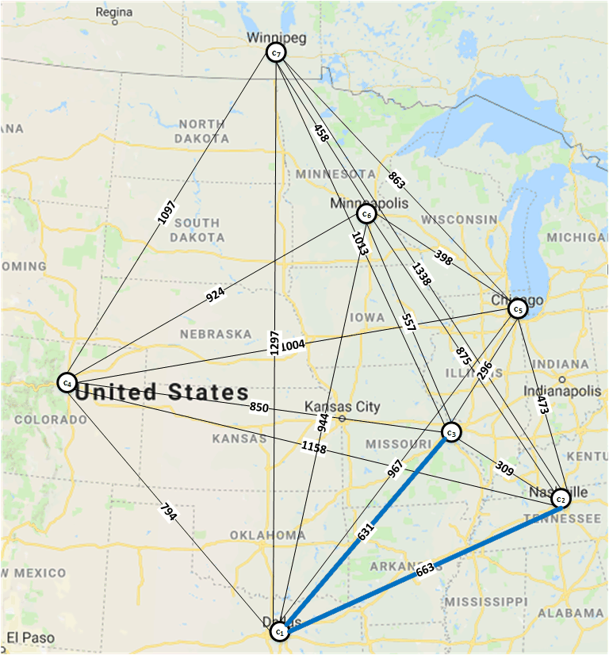
Example of South → North Tour

Slide 20
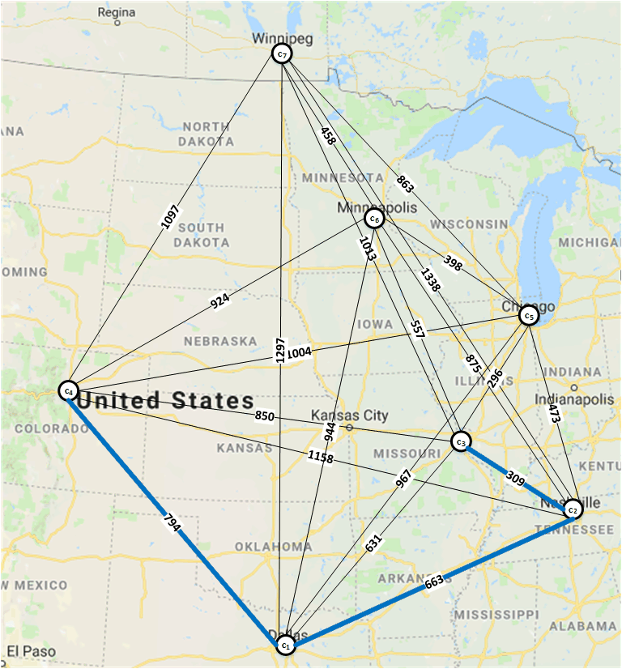
Example of South → North Tour

Slide 21
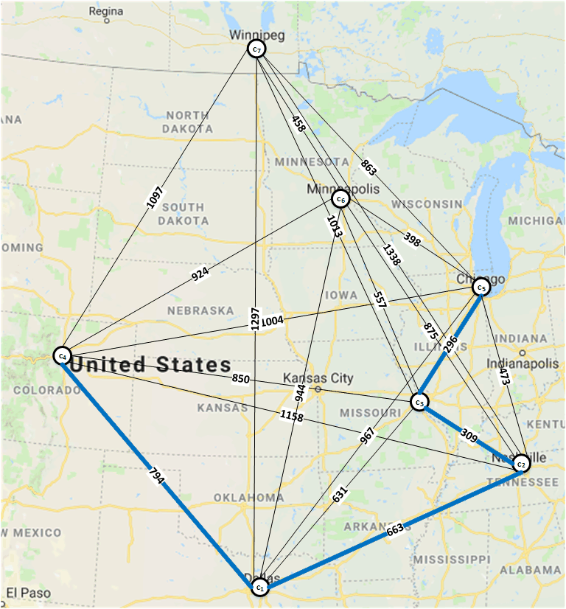
Example of South → North Tour

Slide 22
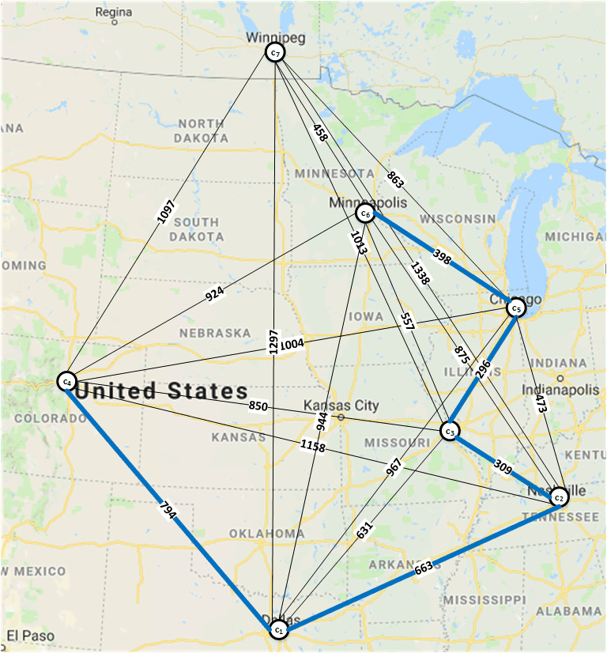
Example of South → North Tour

Slide 23
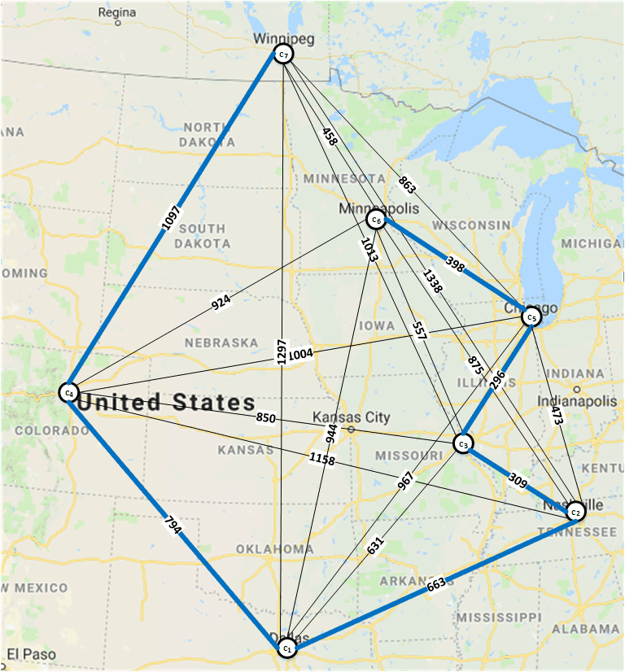
Example of South → North Tour

Slide 24
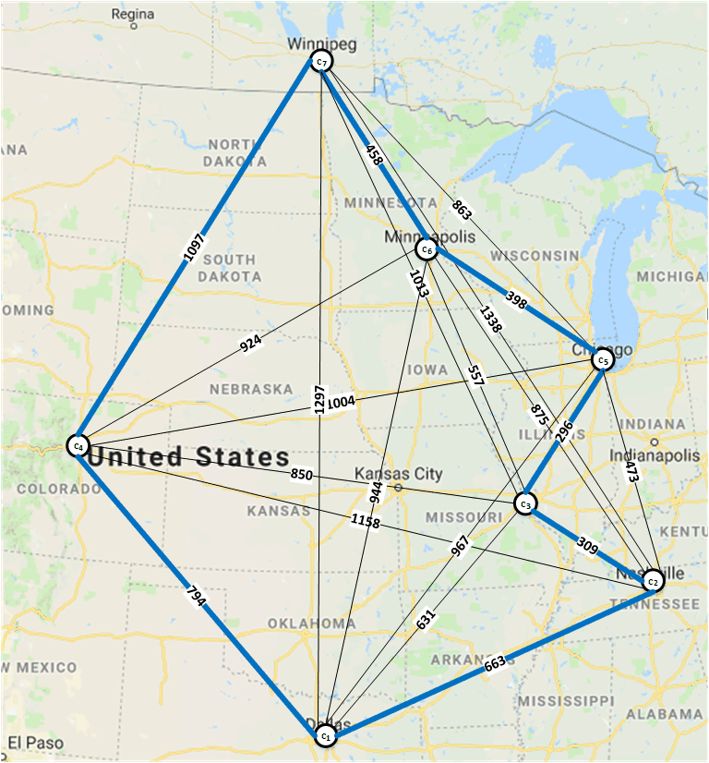
Example of South → North Tour

Slide 25
Bitonic Tour for TSP
More details in Deliverable B Specification, and papers on the Bitonic Tour (see Topic Intros)

